Slide 1
Clinical Practice with Military Families
Ricardo Carrillo, PhD
Professional Forensic and Trauma specialized private practice

Slide 2
Getting Paid
Health Net
Medicare,
Medicaid,
Tricare
Veterans Affairs program

Slide 3
Relevant Issues
Grief and Loss
Deployment
Divorce
Rigid communication styles
Aftermath of brain and other injuries
Policies that advocate to “refrain from discussing issues related to deployment.”
Attachment disorders
Co occurring conditions
Violence, chemical dependency, trauma, PTSD

Slide 4
Grief and Loss
Standard practice of dealing with the real and imaged loss of individual family members while in active duty.
Deployment
Divorce
Military member
Spouse
children

Slide 5
Concussive Brain Disorders, PTDS, other types of injuries
Correct diagnostic work ups crucial
Effects, short term and long term from disabling injuries
Specialized treatment for specific injuries
PTSD, multiple approaches offered and limitations to finding referral sources.
Co occurring disorders

Slide 6
Post Traumatic Stress Disorder
Cognitive behavioral approaches
Prolonged Exposure therapy
Virtual Realty research (Navy)
EMDR- eye movement desensitization and reprocessing

Slide 7
Traumatic event & core psychological process
Biological: brain, CNS, sympathetic system
Neuroendocrine system
Serotonergic system
Psychology
Learning
Memory
Cognitive
Perceptions
Self-ego processes
Personality
Emotions
Unc mental processes
John Wilson

Slide 8
Ptsd sx clusters not present prior to trauma
Reexperiencing traumatic memory
Avoidance –numbing (coping)
Hyper arousal (physiological)
Self (ego processes) identity
Interpersonal (affiliation) and attachment

Slide 9
Synergistic syndrome
Behavioral adaptation
Dsyregulated affects
Personality alterations (personaltiy,ego,self)
Altered interpersonal processes (detachment, loss of intimacy, alienation)
Co morbidity
Health related effects
Life course trajectory (developmental patterns
Recovery & healing

Slide 10
INTEGRATION
STABLIZATION , NORMAIIZATION

Slide 11
Clinical Practice
Co occurring disorders and conditions
Comprehensive diagnostic evaluation: Wilson;
Spect studies or other brain imaging procedures.
Trauma informed psycho education: seeking safety, beyond trauma,
Chemical dependency recovery: harm reduction
Individual, family, group, and specialized menu driven services.

Slide 12
Case studies
Tom Vietnam vet
Mark (swat), Iraq military police
David (mask), father deployed out to sea
Marcie, on ship, concerned about abandonment issues with daughter whom is at the CDC

Slide 13
Tom
56 yr old Chicano
Porterville
Vietnam Vet
Three failed marriages
Acute chronic PTSD
Survivor Guilt prevalent
Psychoeducation
EMDR

Slide 14
mark
36 yr old Caucasian male
Iraq & Afghanistan vet
Special forces
Currently employed as deputy sheriff
SWAT team, gang specialist
Acute PTSD symptoms: nightmares
Disassociations
Hyper aroused nervous system
Acute and chronic alcoholism
Cannot view himself as an addict

Slide 15
David
10 year old Caucasian male
Father navy chief petty officer
Deployed for six months
ADHD
Addreral
Elder brother, abusive
Mother, distracted and attachment impaired
Alone with disorganized attachment
Desperately in need of services
Parents in denial

Slide 16
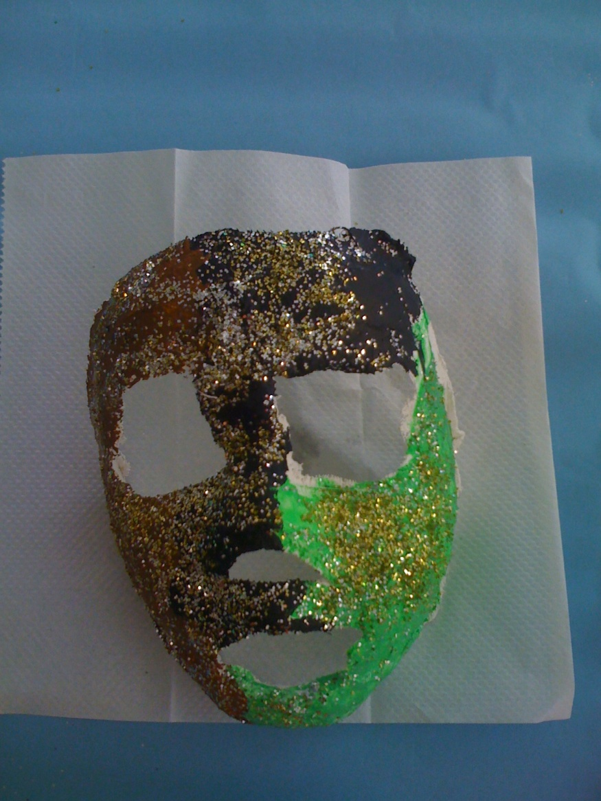
David’s Mask

Slide 17
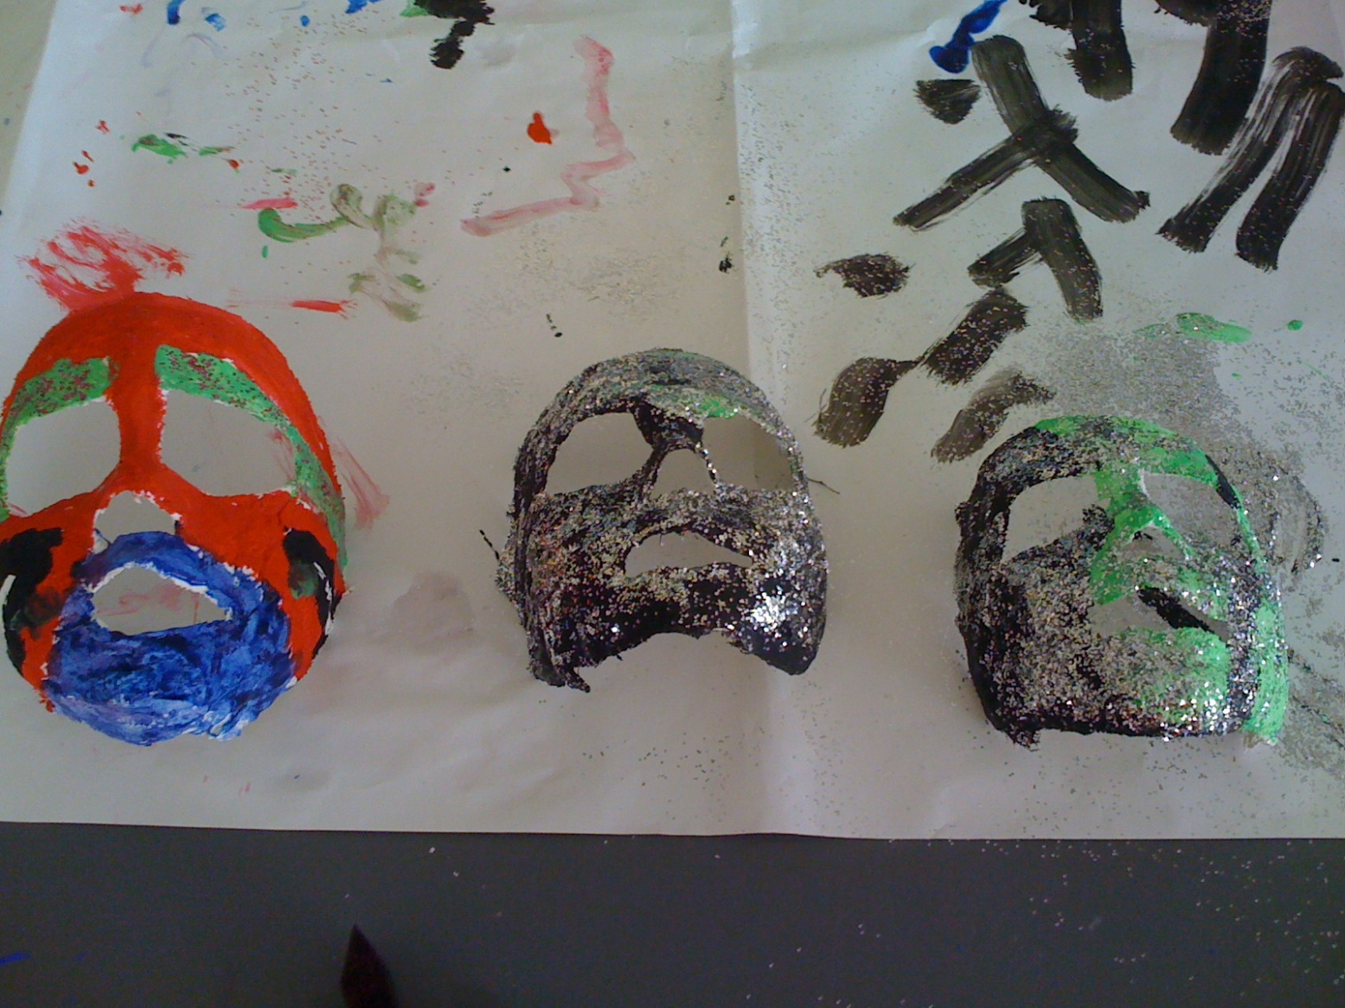
Children’s mascaras

Slide 18
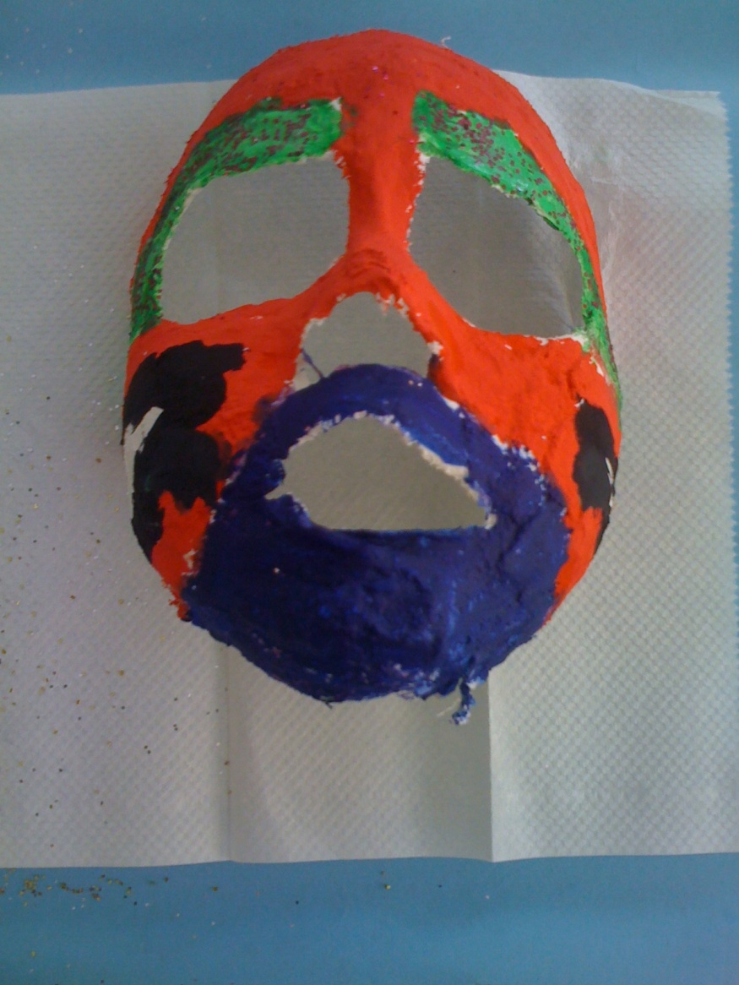

Slide 19
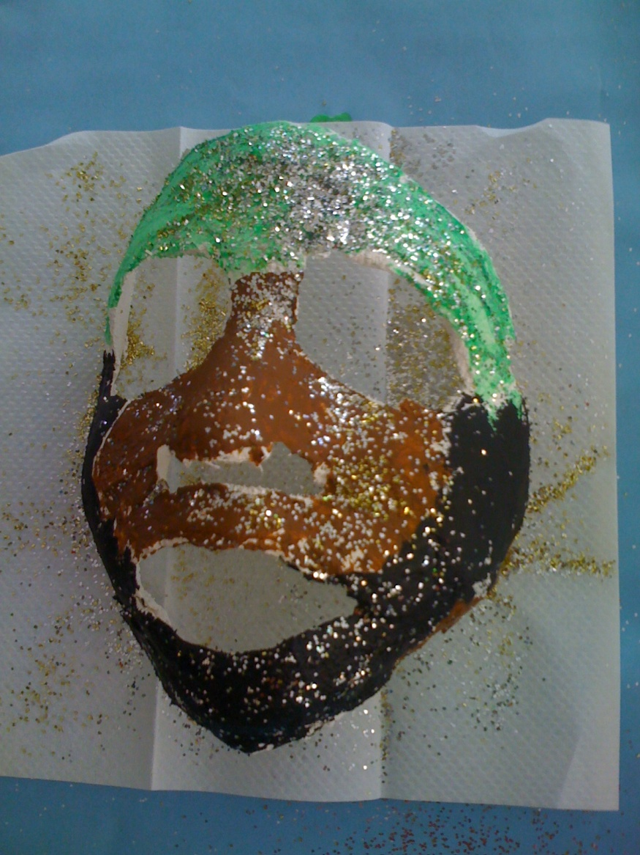

Slide 20
Marcie
23 year old Chicana female from Texas
Single parent
On aircraft carrier
Never home
Concerned about attachment and child’s development
Responsive to problem solving psycho education

Slide 21
Thank you
Ricardo Carrillo, PhD
559 804 1671
rcarrillo03@comcast.net
www.ricardocarrillophd.com
National Latino Alliance for the Ellimnation of Domestic Violence: www.DValianza.org
National Compadres Network: www.nationalcompadresnetwork.com

